Slide 1


NCAA Bracket Predictor Sprint 2
Nate Lang, John Hattas, Kevin Brosam, Alex Berkhout, Matt Petter

Slide 2
Sprint 3 Overview

Slide 3
User Story Example
Alex wants to be able to easy access the predictor and run it. A website that has the predictor hosted would be the best option. He wants to be able to select the year and what indicator/indicators will be used. He also wants it to show the matchups and each winner and loser. He also wants to be able to easily run multiple predictions.

Slide 4
Tests

Slide 5

PRODUCT DEMO

Slide 6
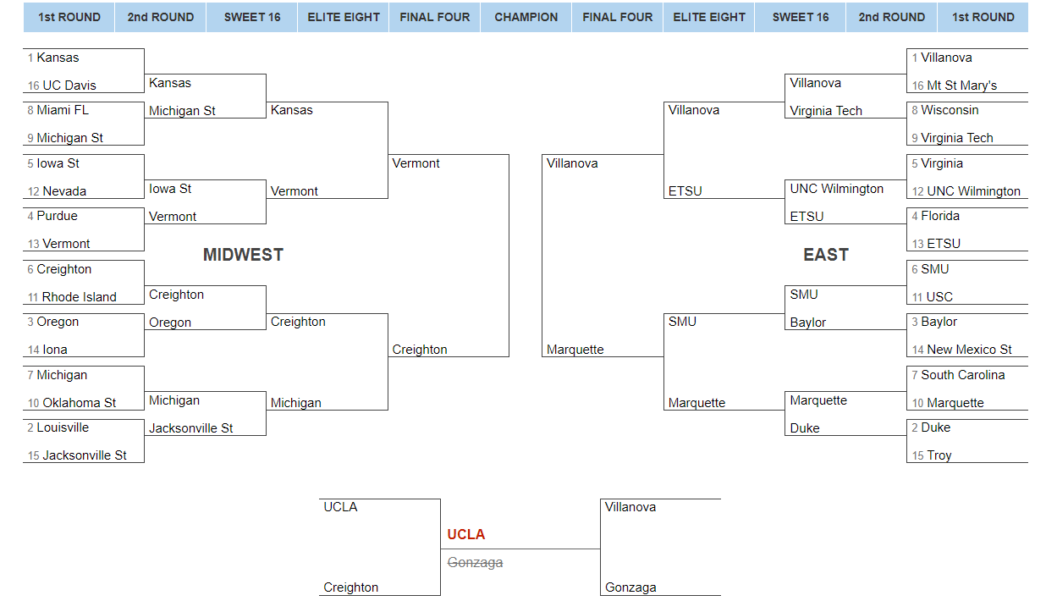
Hosted Website and Bracket
https://ncaabracketpredictor.herokuapp.com/

Slide 7
Backlogs
Sprint Backlog

Slide 8
Product Backlog

Slide 9
Sprint Retrospective

